Slide 1
Real estate Datawarehouse project
Natan, Randy, Wen

Slide 2
Data Profiling
Data source
Zillow – Downloadable csv. File
StreetEasy - Downloadable csv. File
NYC Rolling Sales Data – Downloadable, Excel file
Revised Notice of Property Value – API
City Realty – No downloadable resource, No API, need Script

Slide 3
Data Profiling – Data Example
What are the data contained in each data resource
Zillow – Region ID, Region Name, Zip code, Year and Month, fact: median sales price per month
StreetEasy – Neighborhood Name, Borough, Year and Month, fact: median sales price per month
NYC Rolling Sales Data – Region ID, Neighborhood, Borough, Building type, address, sale price, sales date, fact: sales price of individual building
Revised Notice of Property Value – Borough, block, lot, address, market value, assessed value, fact: value of property
City Realty – Address Neighborhood, Beds Price, Date, Building types, fact: sales price of individual building

Slide 4
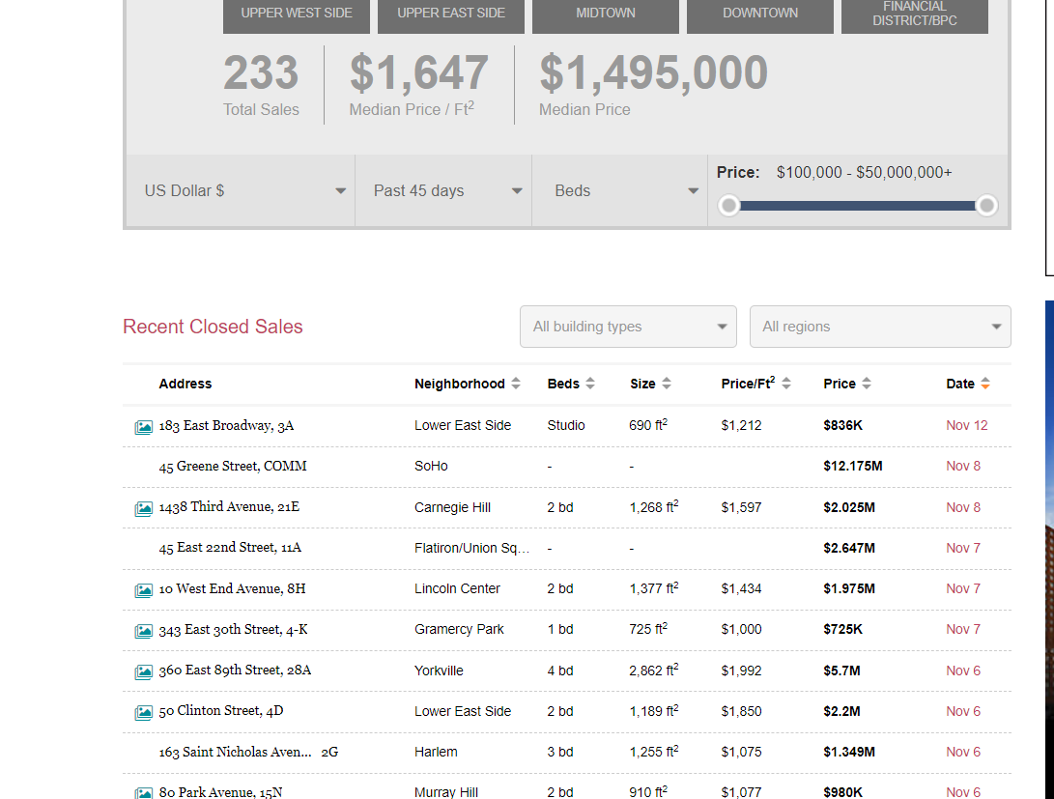
Data Profiling –Problem
The data from City Realty has high quality.
It exists on the level of each building sold.
However, it is very Dynamic
Our team need to scrape data from Website but not sure how to get the elements.

Slide 5
Conceptual Architecture
Infrastructure
Source Data - - one schema containing one table for each of the data sources, ie. Zillow table, StreetEasy table, NYC rolling sales table
Data is then conformed and placed into two fact tables – one database schema
Fact table on individual building sales – dimensions are building, location, and sales date. Fact is sales price
Fact table for monthly sales – dimensions are location, and sales date. Fact is median sales price

Slide 6
Schema, Dimension, and fact
Sample Dimension fields for individual building sales grain
Date - Year, Month, Day
Location - Borough, Neighborhood, Address, Zip Code
Building type – Rent, Condo, Coop
Fact- Sales Price
Sample dimension fields for monthly sales grain
Date – Year, Month
Location – Borough, Neighborhood, Zip Code
Fact – Median sales price

Slide 7
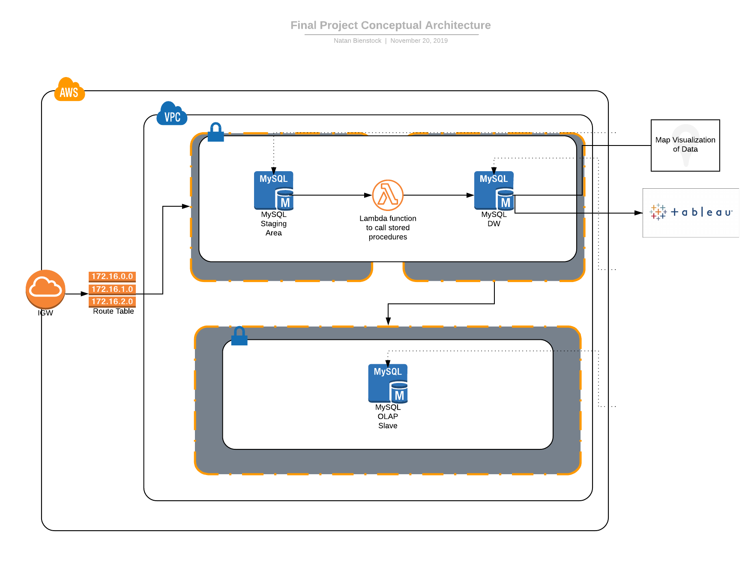
CONCEPTUAL aRchitecture

Slide 8
Conceptual Architecture – Challenge
Checking for duplicate data (data counted in both Zillow and StreetEasy)
2. Combining the different monthly facts – how do you get the average of two different medians and add them with another average?

Slide 9
Plan for rest of semester
By 12/4
Have data in data warehouse – includes conforming dimensions and facts and set up architecture in AWS
Use stored procedures to update data warehouse
Set up data scripts in Python to get updates and add to database
By 12/11
Have visualizations in Tableau
Maps API connected

